Slide 1

HANDS-ON WITH REACT
Inverse Data Flow

Slide 2
Inverse data flow
A component that contains another component is called a “parent”, and the contained component is called a “child”.
In React, data flows down from parent to child, not the other way around.
However, sometimes child components need to trigger state changes higher up in the hierarchy. This is possible, but we’ll need to think a little differently.

Slide 3
Inverse data flow
We sometimes need to pass State back up into the parents, just as we do props. This means we can change the State in the child and then pass it up to allow it to come back down.
This may seem counter intuitive, but it is important to consider that there may be multiple components and children that all depend on this State, we have to change it for all of them at the same time.
State is the ‘Single source of Truth’

Slide 4
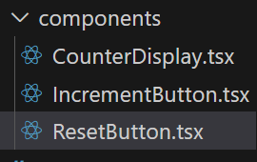
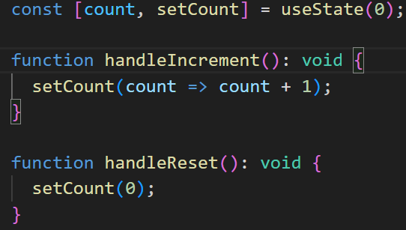
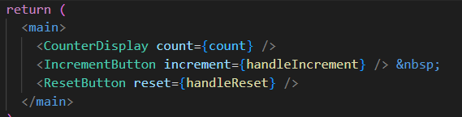
Inverse data flow
Here you can see that we have created 3 componens. All of them are called into App.ts and all of them pass. There are also 3 functions which are passed as Props to the parents

Slide 5
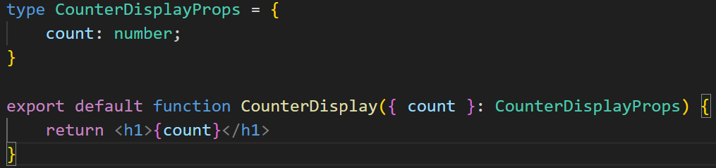
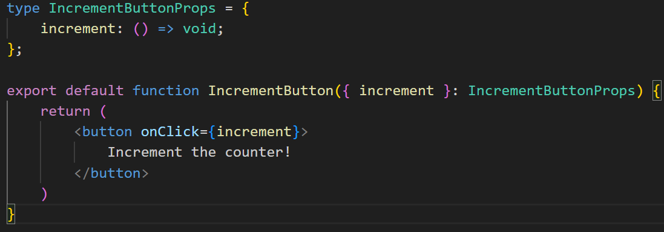

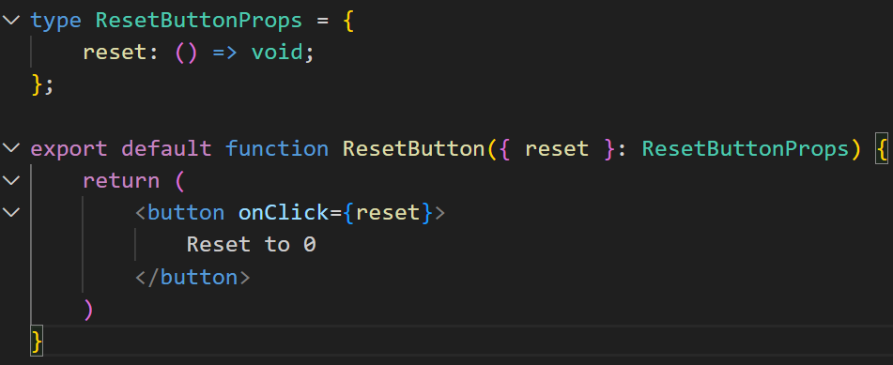
Inverse data flow
Each component takes the props (which is really State) and then updates the Virtual DOM with that data

Slide 6
Inverse data flow
The result is that State created in the child is updated, passed to the parent as Props and then returned to the Child.
Updating any and all children who are dependent on that state

Slide 7
QuickLab 9
Inverse DataFlow

Slide 8
HANDS-ON PROJECT
At your own pace, work through
Challenge 1
Challenge 2

